Slide 1
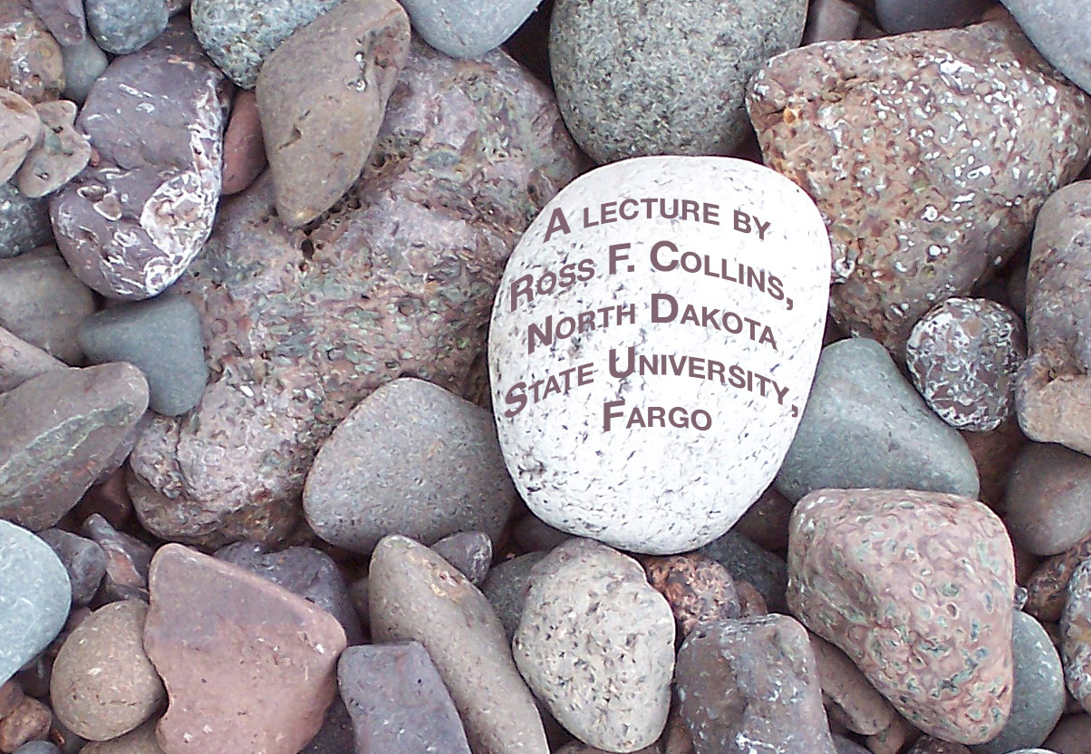
Ethics
and mass media photography

Slide 2
Professional ethics
Every profession has established ethical standards.
Some require ethical behavior to practice.
In mass media, you are not required by law to be ethical.
You also are not required by a professional standards body to be ethical.

Slide 3
Ethics is not law
It may be ethical to obey the law. But ethical standards go beyond legal requirements.
The law does not necessarily give you direction on what is appropriate professional behavior.
In the United States, the media are free to publish pretty much whatever they see fit.

Slide 4
Ethics and law
Ethical questions, then, are not usually subject to fear of legal consequences.
It’s instead a matter of doing what’s right, what should be done, or what accepted professional standards ask us to do.

Slide 5
Consequences
While journalists may not face legal consequences, they may face society’s outrage.
They may also face financial consequences, as advertisers refuse to support an unethical journalist.

Slide 6
Ethics concerns
Concern over media ethics seems to have become more acute in the last few years.
Particularly this seems true in photojournalism.
With digital media it has become a lot easier to alter a photo.

Slide 7
Ethics guidelines
How can photographers consider ethical standards?
This is not an ethics course. But we can begin by considering classic approaches to making ethical decisions.

Slide 8
Deontological approach
The deontological, or duty-based approach as advocated by Kant emphasized general rules.
For example, if you believe “tell the truth always,” then you must tell the truth.
You don’t consider the consequences, even if the truth hurts.

Slide 9
Duty-based ethics
Duty-based ethical photographers, for example, would likely not remove an ugly pimple from a person’s face, even if it was not a permanent feature.
They also would perhaps not shield viewers from perhaps shocking accident images.

Slide 10
Duty to whom?
Of course, a question to ask duty-based photojournalists is duty to whom?
Is a photojournalist’s first duty to tell the truth for readers, or to spare feelings of the subject?

Slide 11
Duty and consequences
Is a photographer duty-bound, in another example, to photograph police pulling a drowning victim from the Red River?
If you believe you have a duty to reflect the truth, you would have to use this photo.
But what might be the consequences?

Slide 12
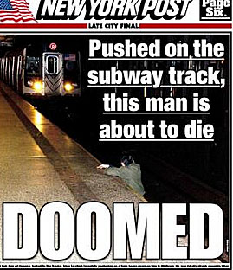
Duty and consequences
Here is a more recent example. Was it ethical to publish a photo of this victim who was pushed onto the subway tracks and about to be run over?

Slide 13
Teleological approach
We realize the consequences of such duty-based decisions may be unpleasant.
Perhaps not considering consequences is unethical.
Those who believe this are consequence-based ethical decision-makers.

Slide 14
Utilitarian approach
Under this consequence-based reasoning, Mill’s utilitarianism guides some photojournalists.
The familiar principle is “the greatest good for the greatest number.”

Slide 15
Greatest good
Utilitarianists might argue in the examples above that accident photographs, even if graphic, should be published because it will serve to deter people from careless behavior, and shows the world as it is—not always pretty.

Slide 16
Consequences
But other consequence-based journalists may argue the consequences of such publication on the victim or victim’s family is not worth the benefit.

Slide 17
Greatest good
In fact, we see fewer graphic accident photos published today, as research has shown the “deterrent” argument to be mostly false.

Slide 18
Greatest good for whom?
We know more people do want to see gruesome accident photos for the same morbid curiosity that causes people to slow down to look at highway accidents.
But “because it sells” is not really an ethical argument, unless you believe in ethical egoism: “Greatest good for me.”

Slide 19
Harm Principle
Journalists sometimes evaluate more critically Mill’s “Harm Principle.” This is, does the good outweigh the harm?

Slide 20
What is harm?
But what is “harm?”
If you offend a reader with a controversial photo, are you really harming them?
Many journalists would argue that giving offense does not meet the bar for “harm.”

Slide 21
Harm
To evaluate the extent of harm, we need to see clear, demonstrable harm, say some journalists.
That is, something that hurts your business, your reputation, your bank account or your health.
Under this definition, simply shocking someone is not “harm.”

Slide 22
Ethical egoism
But that doesn’t mean it’s ethical. Why offend needlessly? To get awards and fame?
In fact many journalists do follow principles of ethical egoism.
They will make decisions based on self-interest.
You would, therefore, publish or broadcast an image of a public official committing suicide because it definitely will attract lots of readers and viewers, and possibly win an award.

Slide 23
Ethical egoism
We know well that many media practitioners operate this way.
Many people generally think the principle ought to be: “Look out for number one.” “Maximize our profit.”
These are actually egoistic approaches to ethical standards, yet they see widespread acceptance in American society.
Do we really consider this an “ethical code,” however?

Slide 24
Profit and media ethics
We know nearly all media operations in the United States are private companies designed to make a profit.
In fact, they need a profit to stay in business, and this may guide most decisions among many practitioners.

Slide 25
Profit and media ethics
Most of us in the United States accept that businesses must make a fair profit, including media businesses.
But what level of profit is “fair?” What level is “excessive?”

Slide 26
Fair profit
In past decades, some Americans have considered that setting a fair profit is a part of ethical standards.
Today, however, most Americans have moved to this principle: There is no such thing as “excessive profit.” It is limited only on how much you can get by with.

Slide 27
Profit and ethics
If we subscribe to profit maximization, perhaps photojournalists will have no problem publishing lurid and tasteless accident photos if they will attract more attention.
We also will have no problem removing or adding objects in photos to improve them.

Slide 28
Ethics and consequences
But ethical egoism must accept that choices have consequences.
If we publish shocking accident photos and false scenes, what response may we see from readers or viewers? From advertisers?

Slide 29
Consequences of taste
Media practitioners generally operate locally or regionally. And regional tastes are different.
An audience in a smaller, more conservative community may be outraged by a photo perfectly acceptable in a large metro community.

Slide 30
Practical standards
This means even ethical egoists in profit-making media organizations must set practical standards to survive.
As the French expression goes: “Even bad taste has its limits.”

Slide 31
Golden rule
Some photojournalists operate by ethical standards of the Golden Rule:
“Do unto others as you would have them do unto you.”

Slide 32
Golden decision-making
The Golden Rule, for example, would tell you not to publish graphic accident photos because if you were the victim’s family you would not want to see them published.

Slide 33
But what is golden?
The problem with the Golden Rule is similar to a problem with consequence-based ethical standards: predicting the consequences.
Just because we would not want accident photos to be published, how do we know what the family wants?

Slide 34
Wrong assumptions
In fact, our presumptions may be wrong.
In one actual photojournalism ethics case locally, a photographer published photos of two students who had been arrested for underage drinking at a party.
The students were on a bench outside the courtroom waiting to appear in court.
The students’ names were used in the cutline.

Slide 35
Wrong assumptions
Many who criticized the photo said the parents would not want to see this sort of thing publicized. We might think that to be true.
However, the photographer investigated. He found out that in this case, the parents believed it correct to publish the photo. They wanted their children, and other underage drinkers, to see consequences of their actions.

Slide 36
What is truth?
Many photojournalists make ethical decisions based on the mission of their employer.
What is the mission of photojournalism? To tell the truth.
But defining the truth isn’t always so clear cut.

Slide 37
Truth and ethics
Is it truthful to publish a photo of a public official’s suicide? Yes.
Is it truthful to publish photos of women in scanty swimsuits at the local beach? Yes.
Is it truthful to publish a photo of three Native Americans drinking from a cheap vodka bottle on a park bench? Yes.
Telling the truth in some cases does not help solve our ethical dilemma.

Slide 38
One general rule
Here is one photojournalism textbook rule (by Fred Parrish):
“Truth is reality viewed, interpreted and photographed by photojournalsts acting in good faith and a sense of fairness and objectivity...

Slide 39
One general rule
...and with the goal of fairly representing to their readers the most appropriate truth of the reality that was viewed, interpreted and photographed.”

Slide 40
Interpretation
Of course, the general rule is open to interpretation. There may be more than one “truth.”
We remember the parable of the blind men and the elephant.

Slide 41
Overall truth
One possibility is looking for the overall truth, not just the small truth. The big picture.
We may need to include more than one photo to tell this.
We will need to use cutlines.

Slide 42
Some guidelines
Here are some general principles for ethical photojournalists.
Have a reason you can clearly state for using a photo.
Have serious concern for the rights and sensibilities of others, but also a serious concern for your responsibility to inform readers.

Slide 43
Some guidelines
Take into account the tastes and sensibilities of the readers you are shooting pictures for.
Consider the mission of your publication.
Take into account your role as a photojournalist in your community and in society.

Slide 44
Poor taste
So we say to consider tastes of your audience. But what is “poor taste?”
Are “good taste” and ethics related?

Slide 45
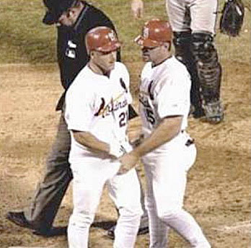
Poor taste?
In fact, it seems that taste and ethics may not be always related.
If I photograph a baseball player grabbing his crotch, is it ethical? Sure.
Does it harm readers? Not according to the definition above.
Is it in good taste, though? Maybe not.

Slide 46
Poor taste
Taste depends not only on your community, but often the age of your readers.
Generally younger readers are more tolerant of “bad taste” than older readers.
Most photojournalists censor themselves based on perhaps ambiguous ideas of “poor taste.”

Slide 47
Matters of taste
Other photojournalists think such self-censorship is ridiculous.
But if you too flamboyantly flout ideals of taste, you damage your reputation and your publication.
You may, however, make a lot of money: papparazzi are well known for having no consideration of standards for good taste.

